Slide 1


Smart Well-Being Monitoring System
January 2025

Slide 2


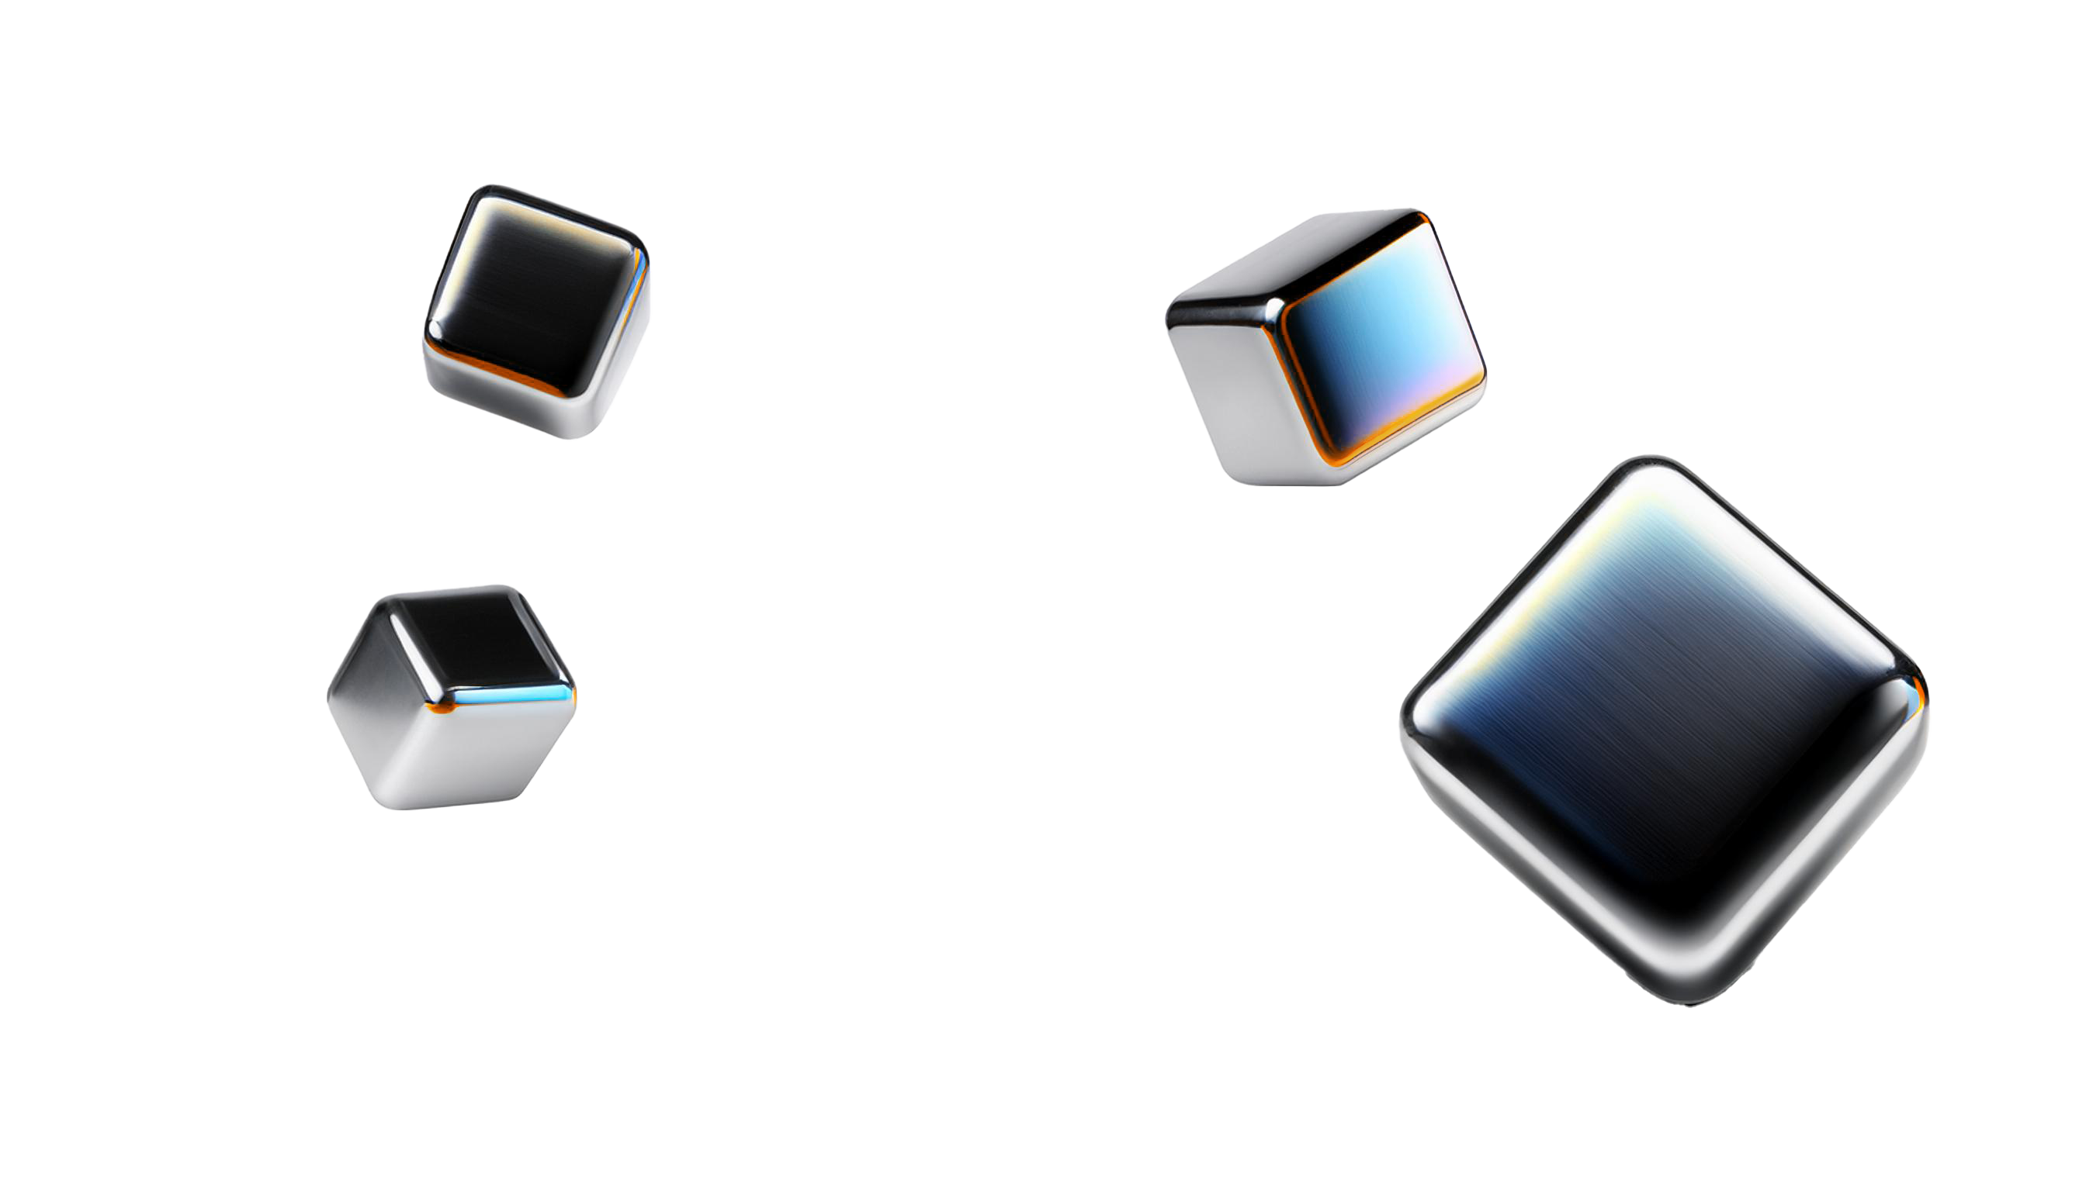
What Might We Need to Investigate in the Project?
An AI-based system that monitors computer-based professionals in real-time, capturing facial features, physiological data, and postural patterns.
Processes this data to assess stress levels and posture stages.
Generates insights with personalized well-being recommendations.
System Definition
Algorithms
Development of algorithms to integrate and process multi-modal data.
Approaches to identify stress levels and posture-related stages from captured data.
Ethical & Privacy Concern
How to handle sensitive data (e.g., physiological metrics) securely.
Strategies to ensure compliance with regulations like GDPR.
2

Slide 3
What Quality Would We Want to Assess?
Effectiveness of the system in detecting stress levels and posture stages.
Precision of facial feature, physiological, and postural data extraction.
Ability to function seamlessly in dynamic environments.
System Accuracy:
User Experience:
Ease of use and comfort while using the system.
Clarity and relevance of the well-being recommendations.
Data Security& Performance:
How to handle sensitive data (e.g., physiological metrics) securely.
Strategies to ensure compliance with regulations like GDPR.
3

Slide 4
How Might We Measure This?
Compare the system's stress detection results against experimental based assessments.
Validate posture monitoring against score-based analysis(RULA).
Accuracy Metrics:
Gather feedback from users on system comfort and recommendation effectiveness.
Conduct surveys to assess perceived usefulness and ease of use.
Usability Testing:
Perform penetration testing to evaluate vulnerability.
Ensure compliance with data protection standards through regular audits.
Security Audits:
4

